Slide 1



1º/2º GRUPO DE TRANSPORTE

Slide 2
FIRE PROTECTION

Slide 3
OBJETIVO
IDENTIFICAR, DESCREVER E OPERAR O SISTEMA DE PROTEÇÃO DE FOGO

Slide 4
CBT
  -26-00-00 (1 a 3)
  -26-11-00 (1 a 7)
  -26-12-00 (1 a 4)
  -26-14-00 (1 a 3)
  -26-15-00 (1 a 3)
  -26-21-00 (1 a 5)
  -26-22-00 (1 a 4)
  -26-23-00 (1, 2, 3 e 6)
  -26-24-00 (1)
  -26-25-00 (1)

Slide 5
ROTEIRO
-SISTEMA DE PROTEÇÃO DE FOGO PARA MOTORES E APU
-SISTEMA DE PROTEÇÃO DE FOGO PARA O LAVATÓRIO
-SISTEMA DE PROTEÇÃO DE FOGO PARA O COMPARTIMENTO DE BAGAGEM
-MENSAGENS NO EICAS

Slide 6
GENERALIDADES
-Extinguisher bottles are installed to extinguish the fire in the airplane’s engines, APU, baggage compartment and lavatory waste container.
-Portable HALON fire extinguishers installed at the front and rear of the airplane can be used to extinguish small fires in the cockpit or main cabin area. A single water extinguisher is an additional option.

Slide 7
SISTEMA DE PROTEÇÃO DE FOGO PARA MOTORES E APU
- SISTEMA DETECÇÃO DE FOGO E SOBRE CALOR
- SISTEMA DE EXTINÇÃO DE FOGO

Slide 8
SISTEMA DE DETECÇÃO
- PROTEGE O MOTOR E APU DE FOGO E SOBRETEMPERATURA
- ALARME SONORO E VISUAL

Slide 9
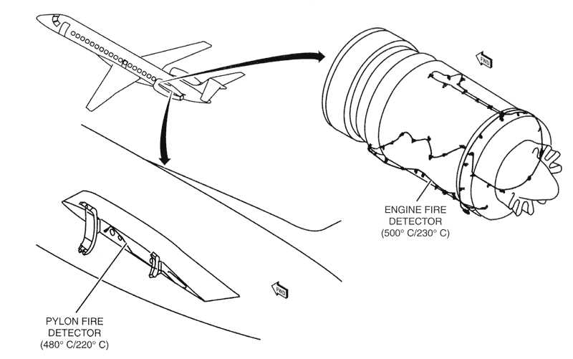
ENGINE FIRE DETECTORS

Slide 10
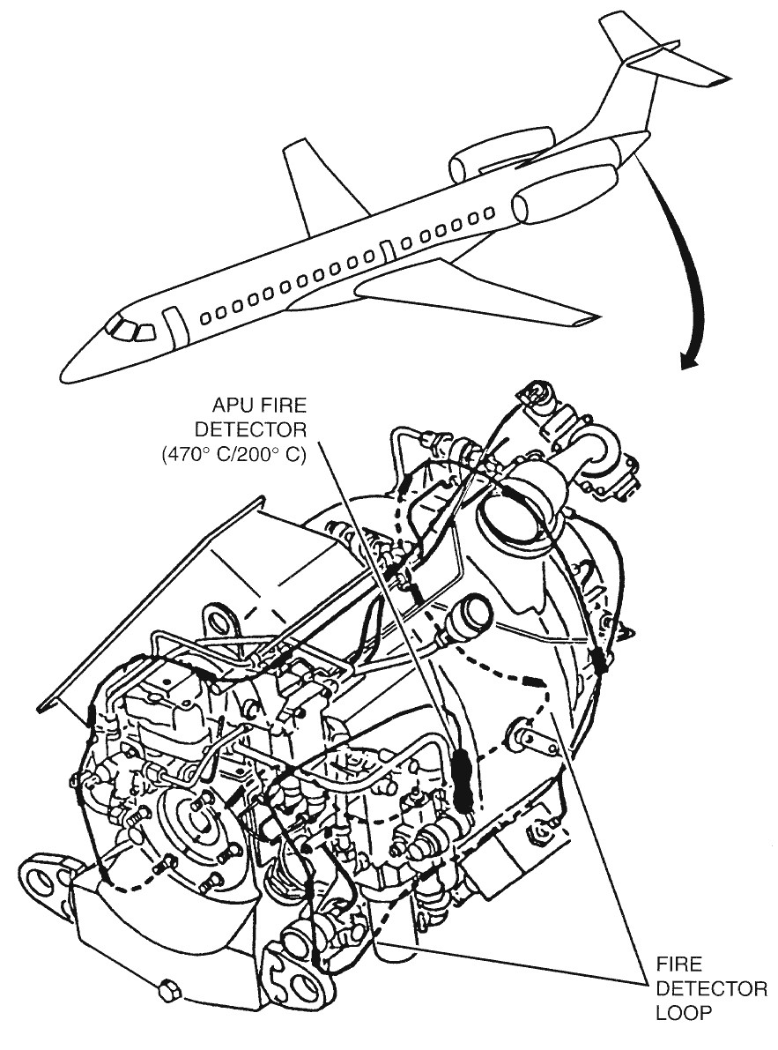
APU FIRE DETECTOR

Slide 11
ALIMENTAÇÃO DO SISTEMA
Essential DC bus 1 engine 1 fire detection system
Essential DC bus 2 engine 2 and the APU
Hot battery bus 1 and 2 engine fire extinguishing system
Essential DC bus 2 APU fire extinguishing system

Slide 12
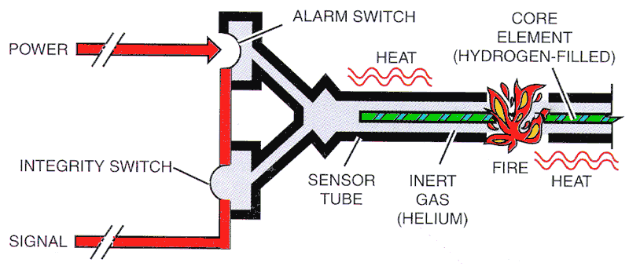
FIRE OVERHEAT DETECTION SCHEMATIC
SENSÍVEL A FOGO LOCALIZADO OU
ALTA INTENSIDADE DE CALOR
SENSÌVEL A SOBRE TEMPERATURA

Slide 13
FIRE OVERHEAT DETECTION SCHEMATIC
Helium
Hydrogen

Slide 14
FIRE OVERHEAT DETECTION SCHEMATIC
-Manual resetting of the fire detection system is not available.
-Upon removal of the fire or overheat condition, a reversible process takes place, and the system automatically returns to the normal standby operation mode.
-An integrity switch continuously monitors the sensor tube’s integrity. The integrity switch is held closed by the sensor’s internal pressure. Should this pressure be lost the integrity switch opens, generating a signal to indicate that the system is inoperative.

Slide 15
FIRE OVERHEAT DETECTION SCHEMATIC
-In the case of failure of any fire detector, a caution message is presented on the EICAS.
-The APU fire detection system provides a signal to shut down the APU automatically in case of fire warning during ground operation.

Slide 16
SISTEMA DE EXTINÇÃO DE FOGO
-02 (DOIS) EXTINTORES DE FOGO PARA OS MOTORES
-01 (UM) EXTINTOR PARA O APU
-INSTALADOS NO CONE DE CAUDA

Slide 17
SISTEMA DE EXTINÇÃO DE FOGO
The engine bottles are cross-connected by two double check tees to provide dual shot capability, thus one or both bottles can be discharged into one or the other engine.
CAUTION: DO NOT DISCHARGE THE SAME EXTINGUISHER
BOTTLE TWICE. ACTUATING THE FIRE HANDLE INTO
AN EMPTY BOTTLE MAY CAUSE STRUCTURAL DAMAGE TO THE BOTTLE.
Notes:
The engine bottles are cross-connected by two double check tees to provide dual shot capability, thus one or both bottles can be discharged into one or the other engine.
CAUTION: DO NOT DISCHARGE THE SAME EXTINGUISHER
BOTTLE TWICE. ACTUATING THE FIRE HANDLE INTO
AN EMPTY BOTTLE MAY CAUSE STRUCTURAL DAMAGE TO THE BOTTLE.

Slide 18
SISTEMA DE EXTINÇÃO DE FOGO
-Single shot capability for the APU.
-A caution message is presented on the EICAS should any bottle be discharged or be inoperative for any reason (failed cartridge, loss of pressure, or loss of power).
Notes:
Single shot capability for the APU.
A caution message is presented on the EICAS should any bottle be discharged or be inoperative for any reason (failed cartridge, loss of pressure, or loss of power).

Slide 19
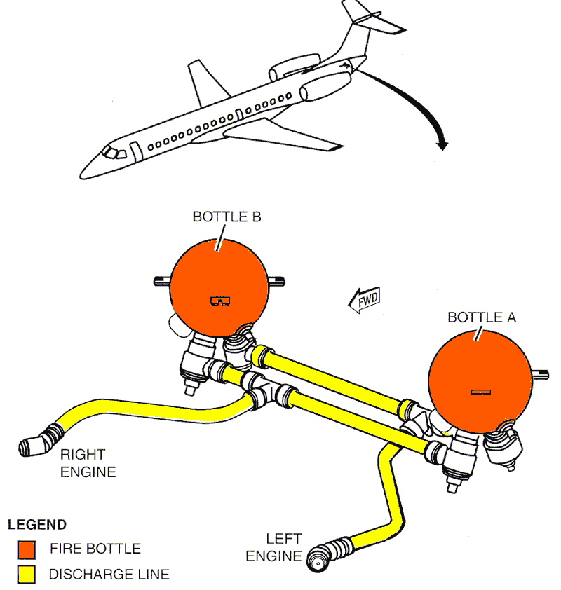
ENGINE FIRE - EXTINGUISHING BOTTLES

Slide 20
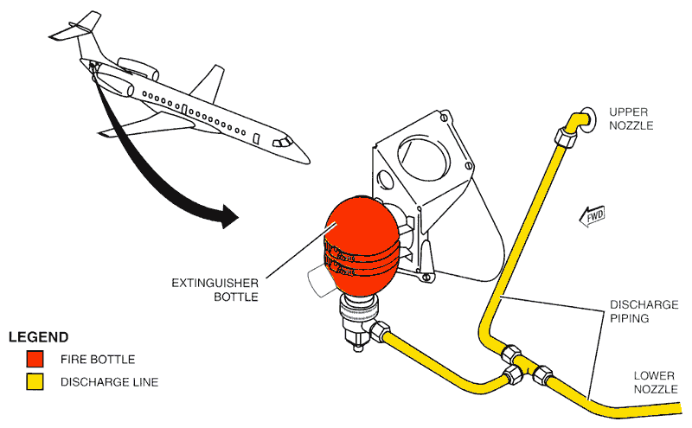
APU FIRE - EXTINGUISHING BOTTLE

Slide 21
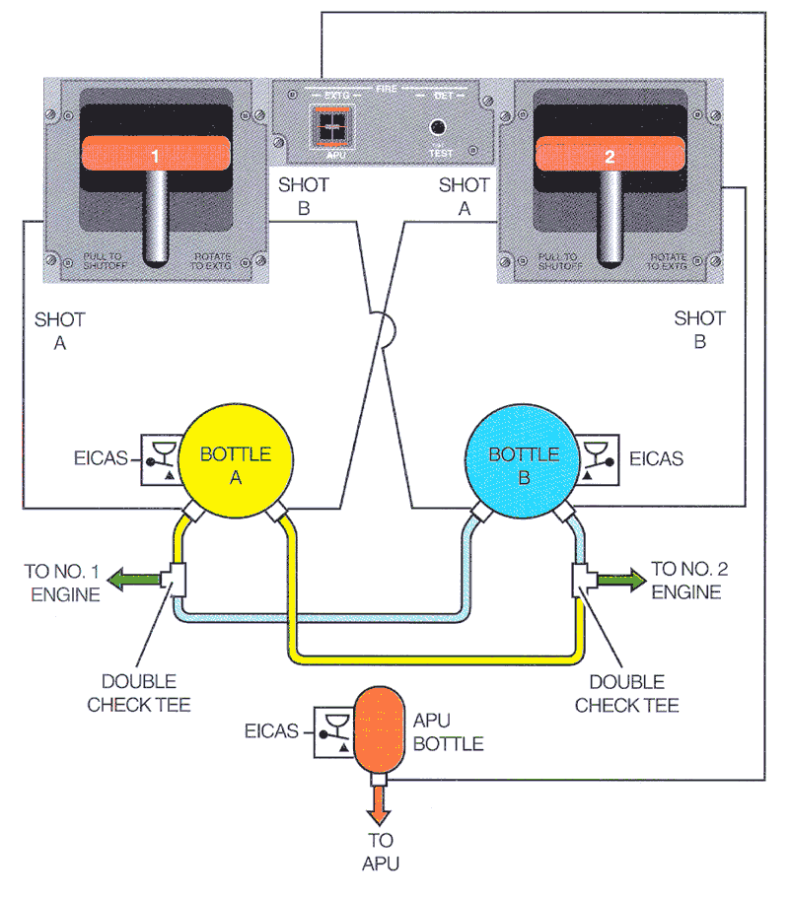
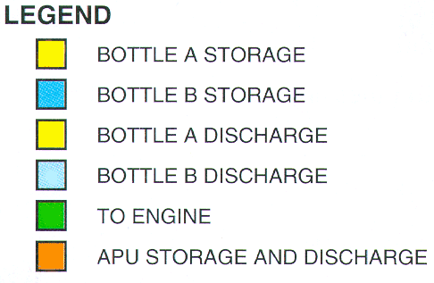
ENGINE AND APU FIRE EXTINGUISHING SCHEMATIC

Slide 22
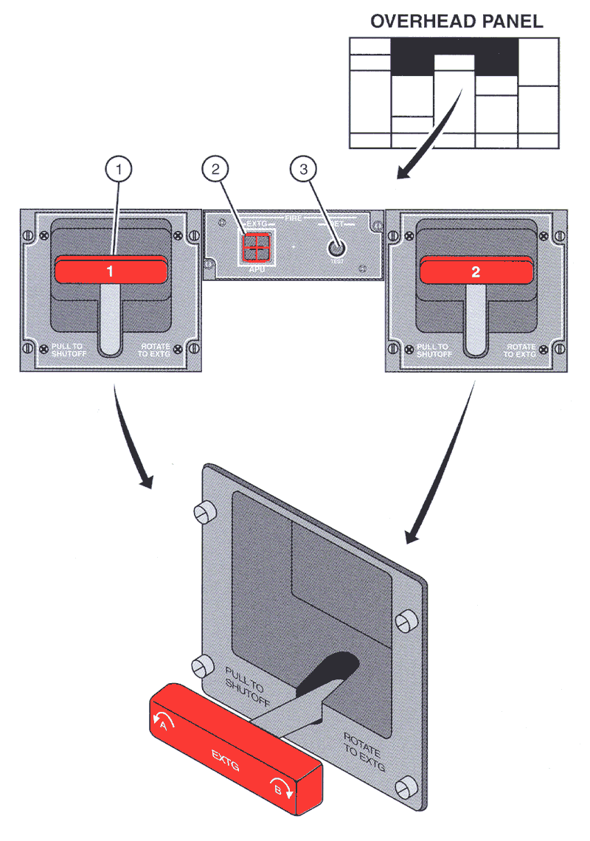
ENGINE AND APU FIRE DETECTION/
EXTINGUISHING PANEL

Slide 23
ENGINE AND APU FIRE DETECTION/
EXTINGUISHING PANEL
ENGINE FIRE EXTINGUISHING HANDLE
-When pulled, it closes the fuel, hydraulic, bleed air, and lip antiicing shutoff valves of the associated engine.
-When rotated counterclockwise or clockwise, it respectively
discharges extinguisher bottles A or B into the associated
engine.
APU FIRE EXTINGUISHING BUTTON (guarded)
-When pressed, it closes the APU fuel shutoff valve and
discharges the APU fire extinguisher bottle.

Slide 24
ENGINE AND APU FIRE DETECTION/
EXTINGUISHING PANEL
FIRE DETECTION SYSTEM TEST BUTTON
-When pressed and held for at least two seconds, it permits the fire detection system to be checked.
-On the ground, when pressed approximately for more than 10 seconds, the APU is shut down, if it is running.
-If it is necessary to repeat the test, wait at least 6 seconds to press the test button again.
- If Fire Detection Test button is held for less than 2 seconds the BAGG EXTG button may remain illuminated. In this case, repeat the test.

Slide 25
-SISTEMA DE PROTEÇÃO DE FOGO PARA MOTORES E APU
-SISTEMA DE PROTEÇÃO DE FOGO PARA O LAVATÓRIO
-SISTEMA DE PROTEÇÃO DE FOGO PARA O COMPARTIMENTO DE BAGAGEM
-MENSAGENS NO EICAS

Slide 26
SISTEMA DE PROTEÇÃO DE FOGO
PARA O LAVATÓRIO
DETECÇÃO DE FUMAÇA NO LAVATÓRIO
- Sensor no teto do lavatório e painel próximo a Galley
- Menos sensível a fumaça de cigarros
EXTINÇÃO DE FOGO NO LAVATÓRIO (AUTOMÁTICO)
- A single fire extinguisher bottle is installed for fire protection of the lavatory waste container.
- No warning is provided in the cockpit when the waste container extinguisher bottle is discharged.

Slide 27
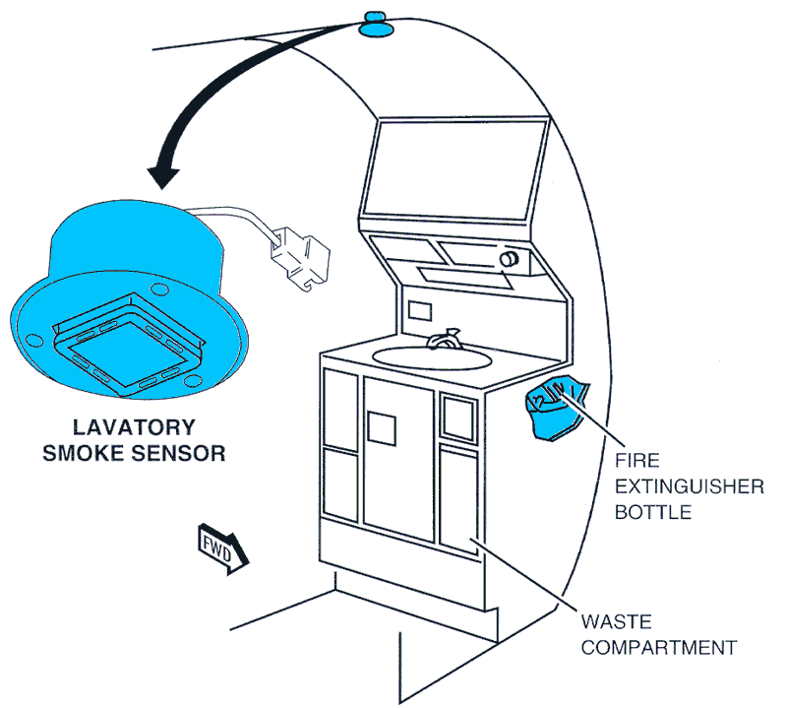
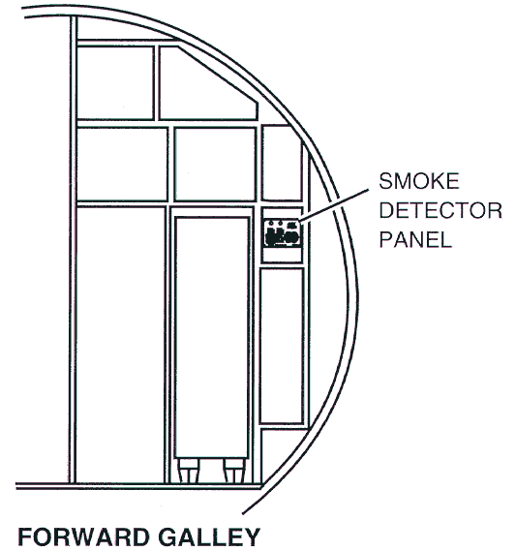
LAVATORY FIRE PROTECTION SYSTEM

Slide 28
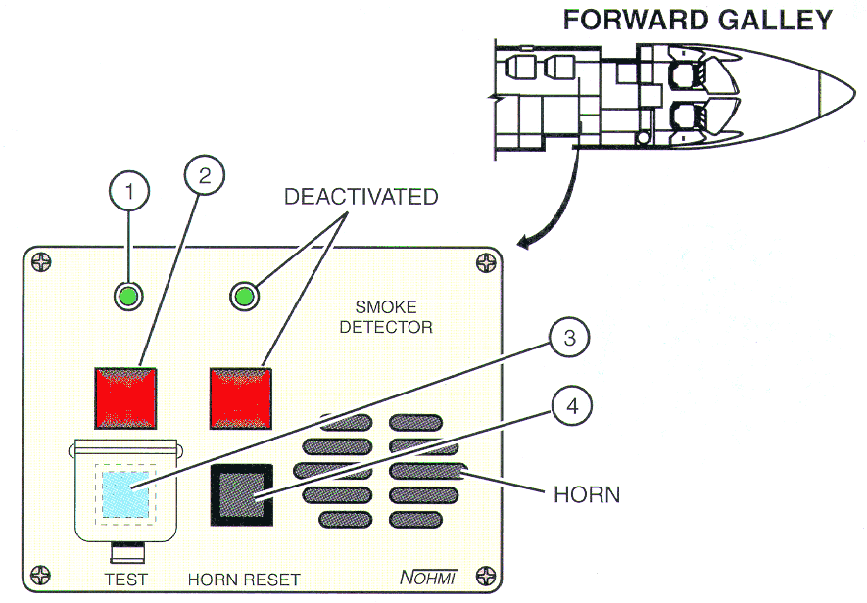
LAVATORY SMOKE DETECTOR PANEL

Slide 29
ROTEIRO
SISTEMA DE PROTEÇÃO DE FOGO PARA MOTORES E APU
SISTEMA DE PROTEÇÃO DE FOGO PARA O LAVATÓRIO
SISTEMA DE PROTEÇÃO DE FOGO PARA O COMPARTIMENTO DE BAGAGEM
MENSAGENS NO EICAS

Slide 30
SISTEMA DE PROTEÇÃO DE FOGO PARA O COMPARTIMENTO DE BAGAGE
SISTEMA DE DETECÇÃO DE FUMAÇA NO COMPARTIMENTO DE BAGAGEM
Flight crew inspection of the baggage compartment is possible for airplanes equipped with an optional sight glass in the rear lavatory partition.
SISTEMA DE EXTINÇÃO DE FOGO NO COMPARTIMENTO DE BAGAGEM (OPTIONAL)
Two fire extinguishing bottles are installed in the rear electronic compartment for baggage compartment fire protection.

Slide 31
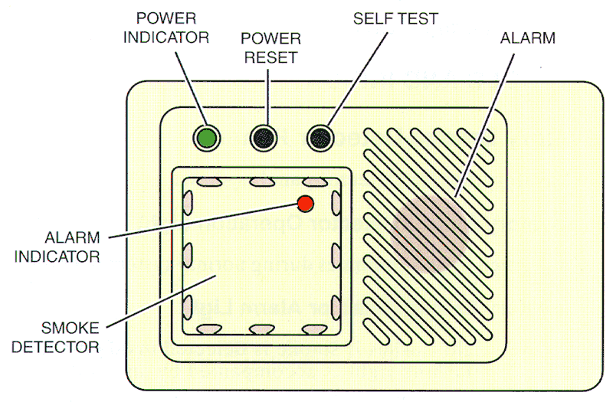
BAGGAGES SMOKE DETECTOR

Slide 32
BAGGAGE FIRE EXTINGUISHING BUTTON (guarded)
− When lit, button indicates that smoke was detected inside the baggage compartment or that the fan has been deactivated.
− Button remains lit as long as there is smoke inside baggage compartment.
When pressed:
− Discharges the baggage fire extinguishing bottles.
− Deactivates the baggage compartment fan.
NOTE: Fire extinguishing agent may activate the smoke detector.

Slide 33
ROTEIRO
SISTEMA DE PROTEÇÃO DE FOGO PARA MOTORES E APU
SISTEMA DE PROTEÇÃO DE FOGO PARA O LAVATÓRIO
SISTEMA DE PROTEÇÃO DE FOGO PARA O COMPARTIMENTO DE BAGAGEM
MENSAGENS NO EICAS

Slide 34
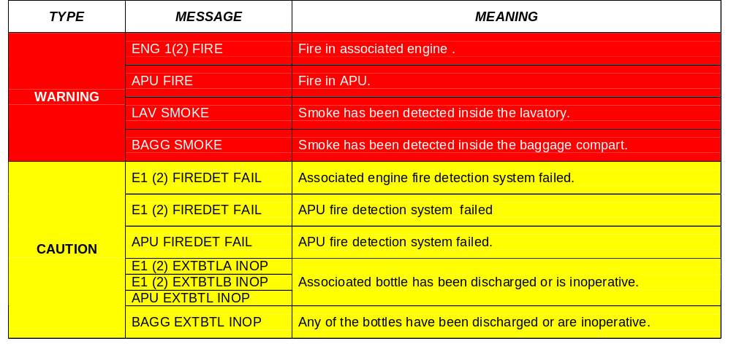
EICAS MESSAGE

Slide 35
ROTEIRO
SISTEMA DE PROTEÇÃO DE FOGO PARA MOTORES E APU
SISTEMA DE PROTEÇÃO DE FOGO PARA O LAVATÓRIO
SISTEMA DE PROTEÇÃO DE FOGO PARA O COMPARTIMENTO DE BAGAGEM
MENSAGENS NO EICAS

Slide 36
OBJETIVO
IDENTIFICAR, DESCREVER E OPERAR O SISTEMA DE PROTEÇÃO DE FOGO

